Slide 1
HAPPIER FANS. CALMER
TEAMS. SMARTER EVENTS.
Welcome to FanAssist™
Better fan experience. Less pressure on your team.

Slide 2


LIVE EVENTS
DON’T KEEP
OFFICE HOURS
Neither do we.

Slide 3
EVERY UNANSWERED QUESTION CAUSES
fan defection

Slide 4
EVERY EVENT
ORGANISER FACES
THE SAME CHALLENGE.
Thousands of fans all asking the same type of questions:
What time does the last act finish?
Where is my ticket?
Can I bring food, I have allergies?
Accessibility enquiries
Refund or ticket-transfer questions
Travel/parking questions

Slide 5

THEY DON’T WAIT UNTIL MONDAY MORNING.
They ask:
Late at night
During ticket sales
On event day
While your team is busiest
www.sumvivas.com

Slide 6
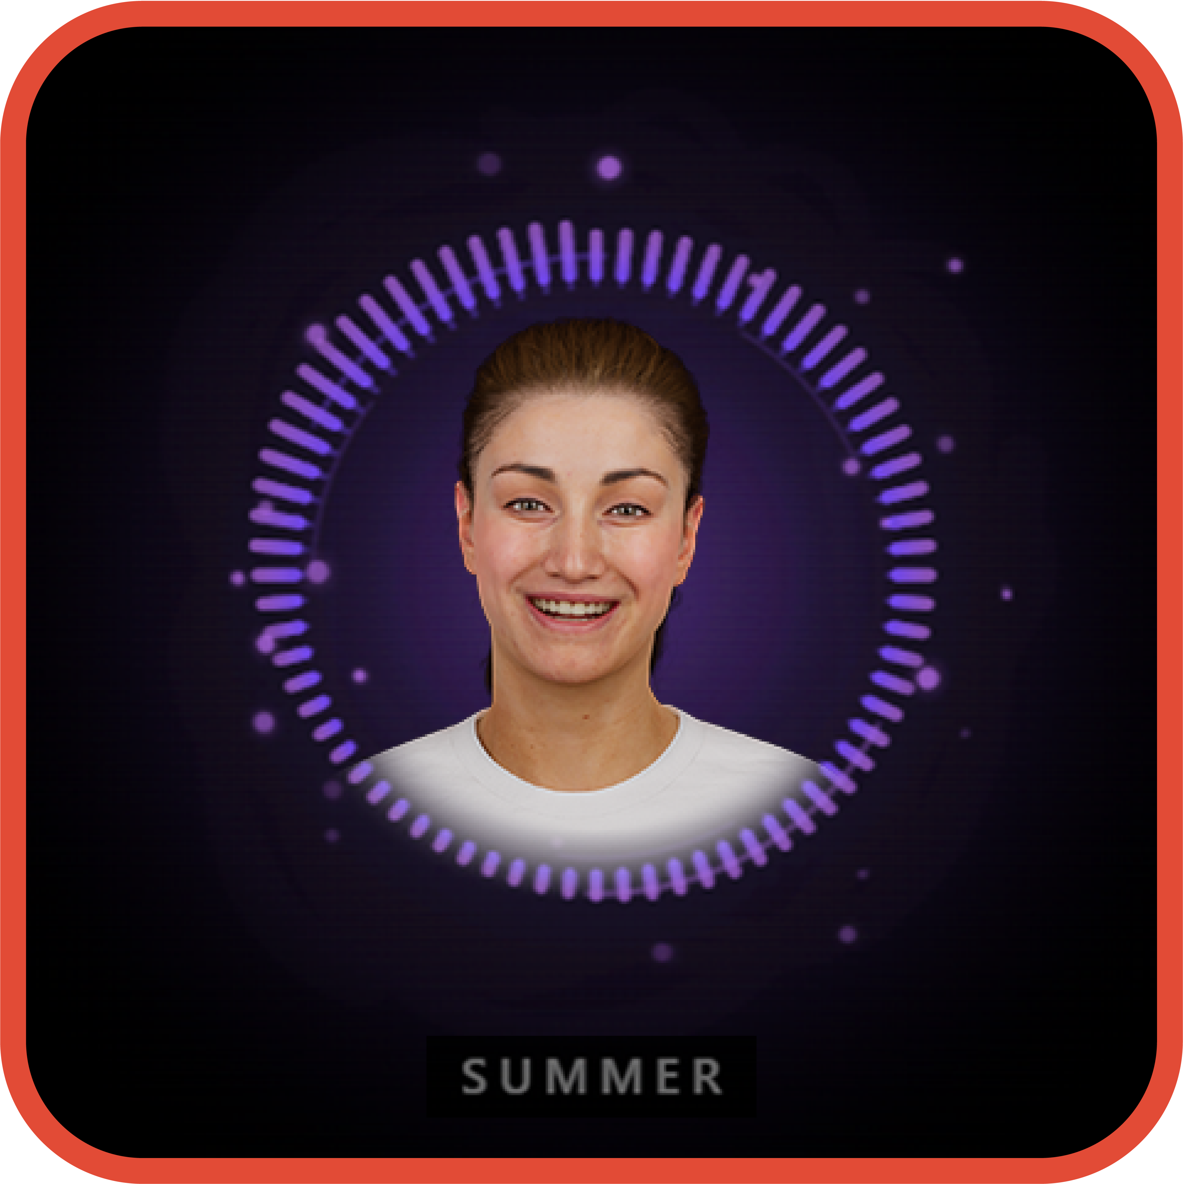
EVERY FAN
GETS AN INSTANT ANSWER.
With FanAssist™
Exceptional Fan Experience.
Lower Customer Service Costs.
Actionable Customer Intelligence.
Stronger Brand Reputation.
Better Event Decisions.

Slide 7
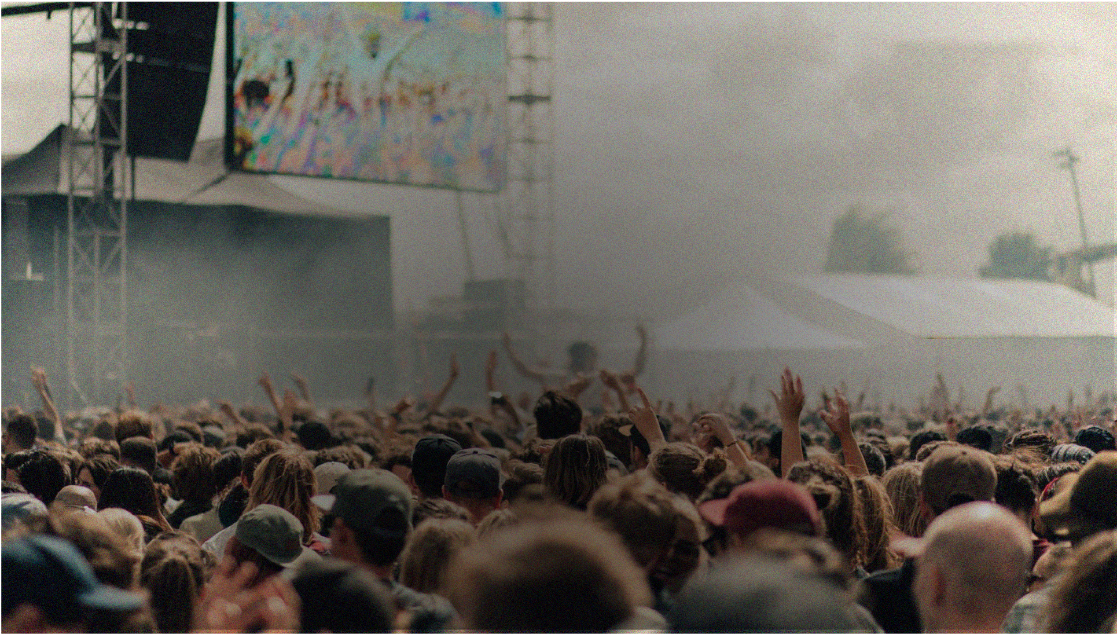
IT’S BUILT FOR LIVE EVENTS
Travel
Lost
Property
Accessibility
Parking
Complaints
Wayfinding
Emergency
Messaging
Everything
fans ask.
Food & Drink
Bag policy
Set times
Ticketing

Slide 8
SO MUCH MORE THAN A chatbot.
Track every conversation,
spot trends and understand
what your fans need.
www.sumvivas.com

Slide 9
HOW FANASSIST WORKS
WE CAPTURE
all your event knowledge and train your FanAssist™ digital assistant.
WE SEAMLESSLY INTEGRATE
with any existing customer service systems, including Zendesk,
Freshdesk and CRM platforms if you use any.
YOU GO LIVE
on your chosen platforms Website • Instagram • Facebook •
WhatsApp • Email Multilingual. 24/7.
YOUR FAN ASKS
A customer sends a question on their preferred channel.
FANASSIST ANSWERS INSTANTLY
Fast, accurate answers. Any time. Any language.

Slide 10

HAPPY FANS, LESS
PRESSURE ON YOUR TEAM
Thousands of enquiries handled.
No additional customer service headcount required.

Slide 11
PROVEN
AT SCALE
FanAssist™’s last festival stats

Slide 12
Customer
satisfaction
94%
Messages
9,282
Accuracy
of information
98.5%
Customer service hours saved in
5 days
479hours
Handled
by FanAssist™
98.4%

Slide 13
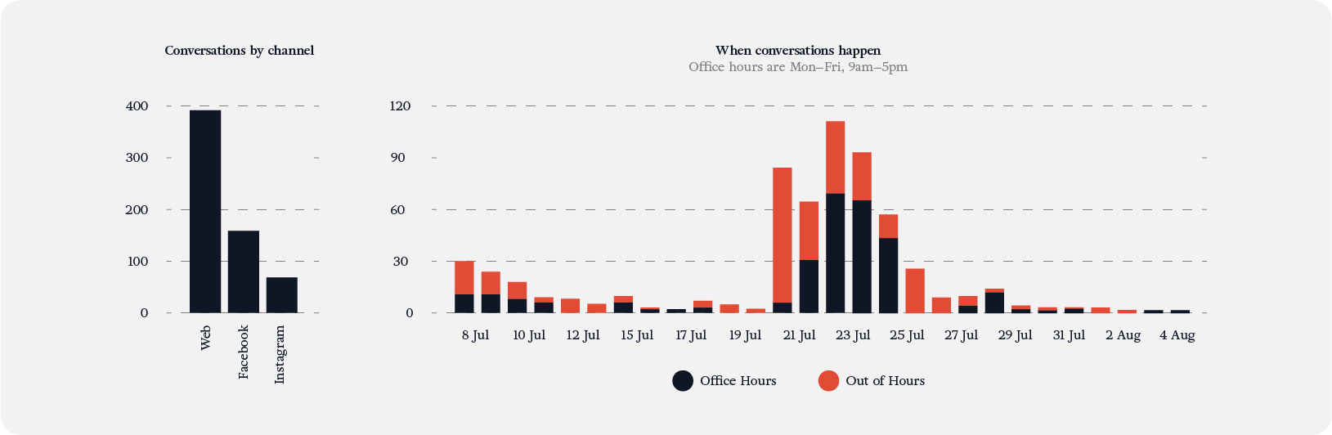
TURN CONVERSATIONS INTO INSIGHT
Sentiment
Top Questions
Live Issues
Accessibility
Peak Times
Operational Improvements
619 CONVERSATIONS
392 Web / 159 Facebook / 68 Instagram
1,114 MESSAGES
About 2 per conversation
44 PASSED TO A HUMAN
44 Conversations handed off

Slide 14
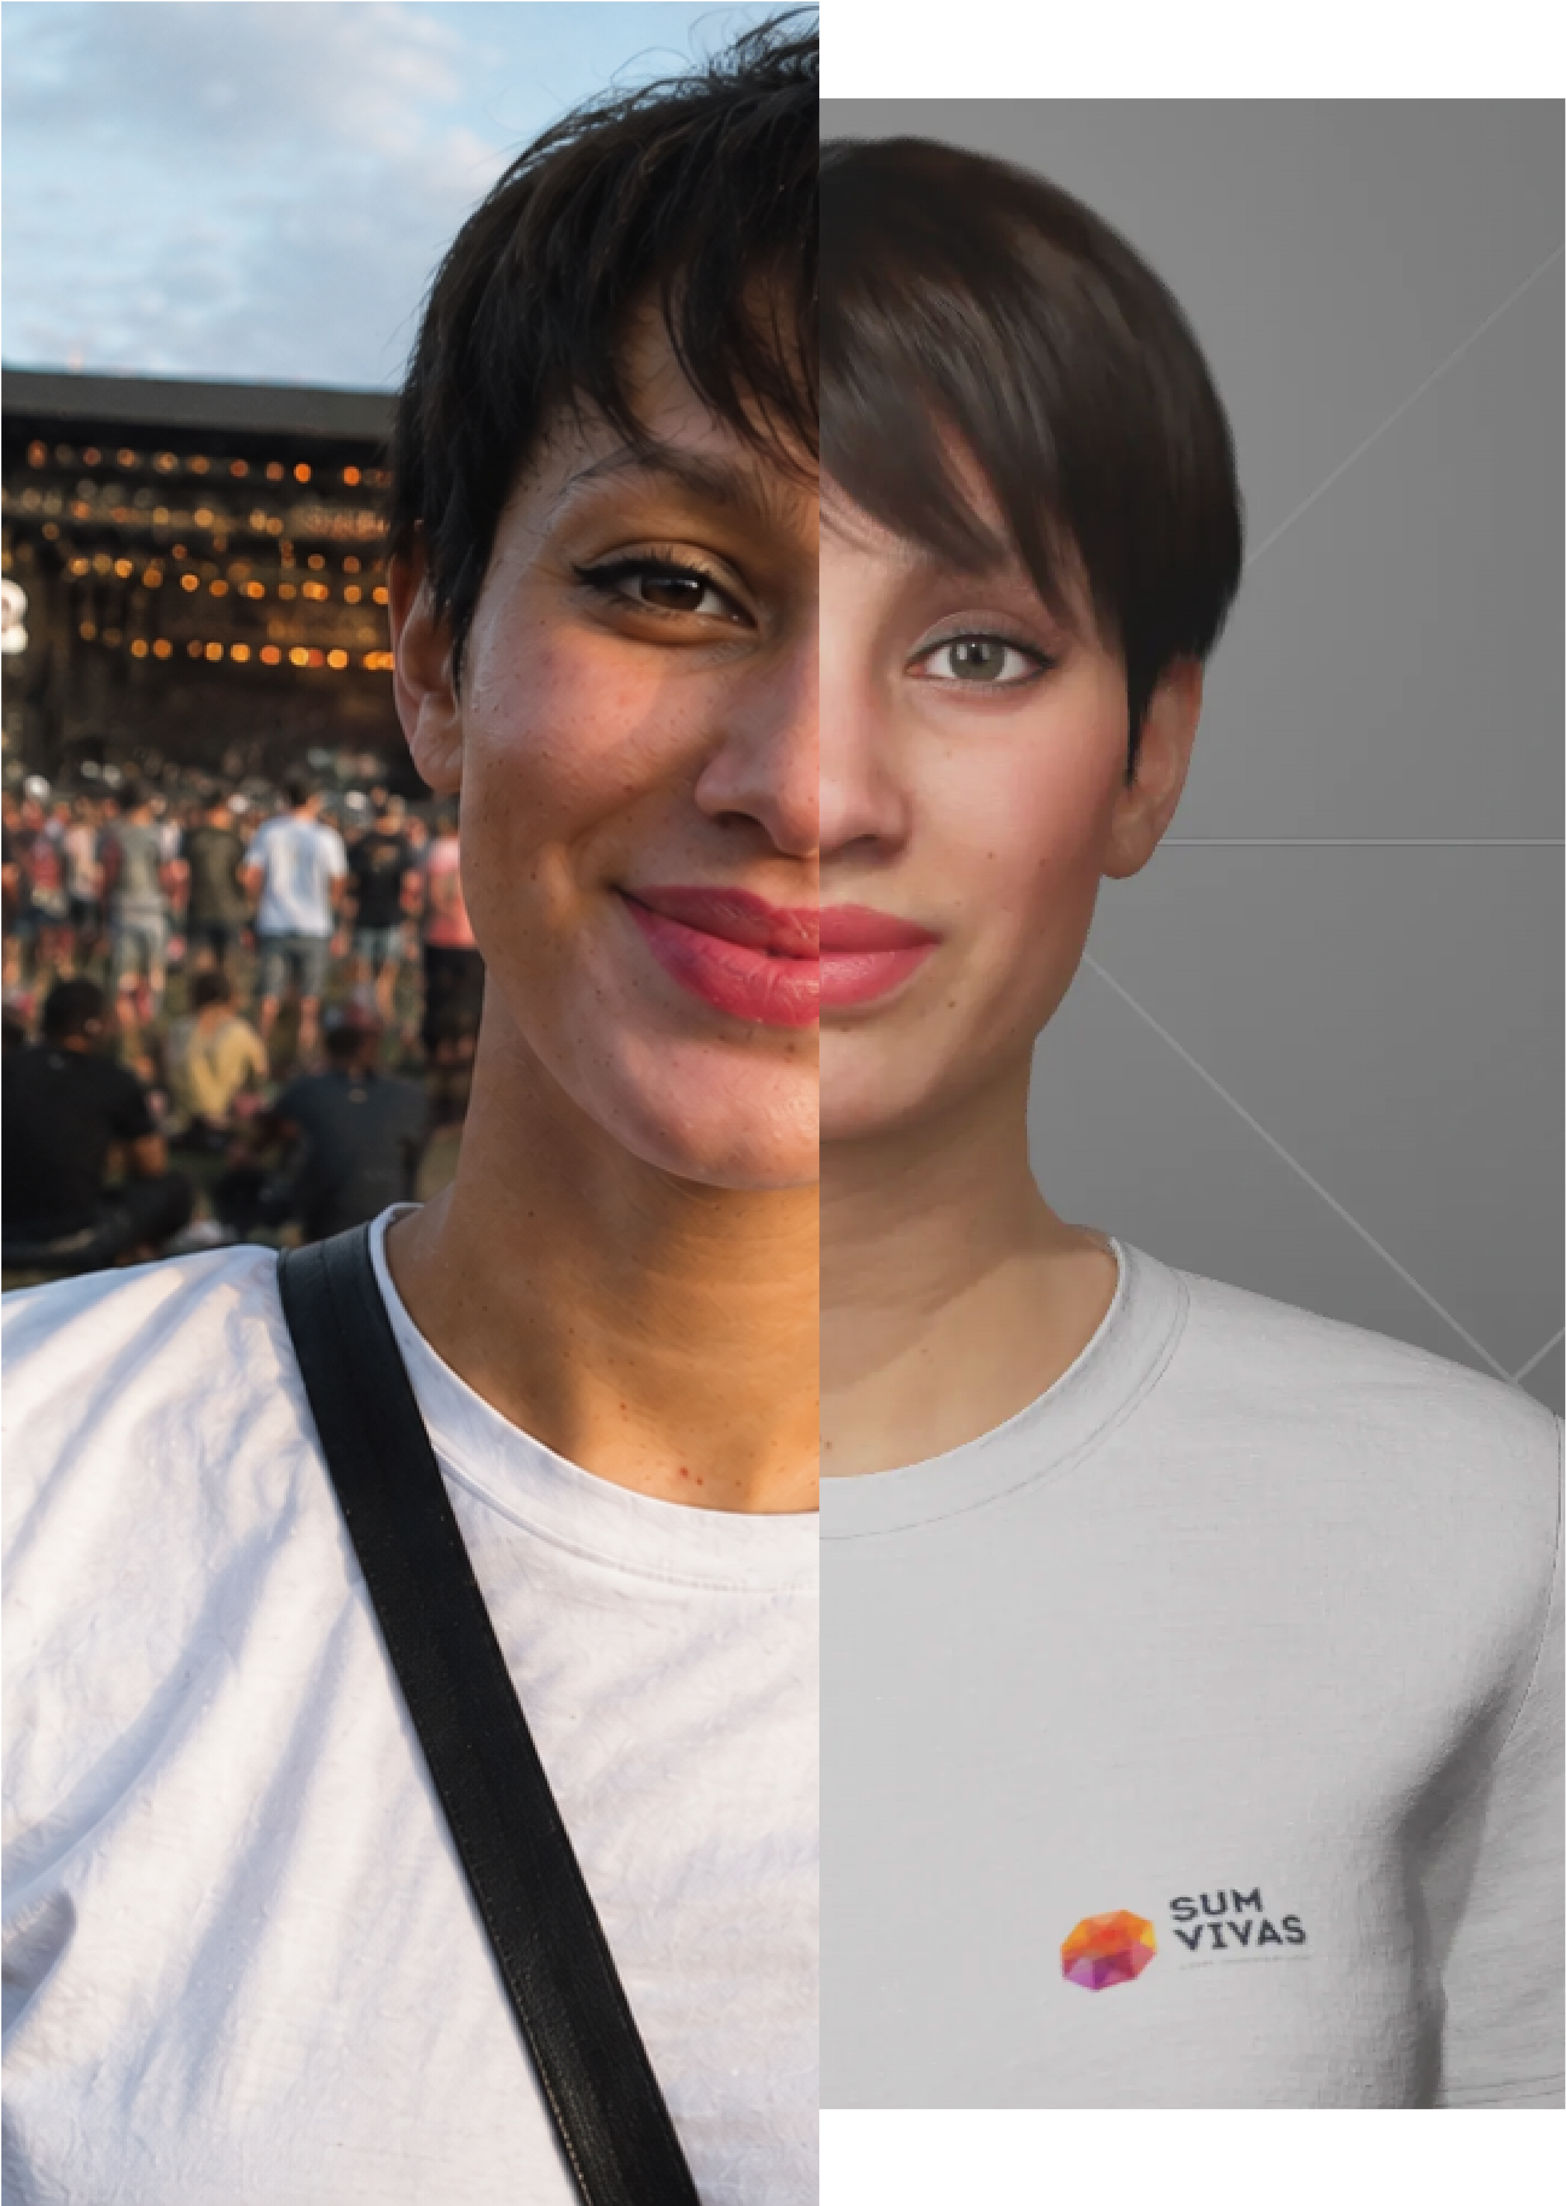
FANASSIST™ BECOMES
AN EXTENSION OF YOUR
CUSTOMER SERVICE TEAM.
Instead of overtime.
Instead of overflowing inboxes.
Instead of hiring temporary staff.
FanAssist™ manages thousands of conversations simultaneously while your team focuses on the fans who genuinely need human support.

Slide 15
SIMPLE PRICING
One off build cost
FROM:
£2,500 IMPLEMENTATION
Recurring monthly
FROM:
£500 PER MONTH

Slide 16

IMAGINE YOUR NEXT EVENT
No waking up to hundreds of unanswered messages.
No team drowning in the same questions, over and over again.
No fans waiting, chasing or getting frustrated.
Just instant answers, calmer teams and happier fans.
Less pressure behind the scenes.
A better experience everywhere else.

Slide 17
LET’S BUILD HAPPIER
EVENTS TOGETHER
WITH FANASSIST™
BY SUM VIVAS
Book a demo denise@sumvivas.com

